Slide 1
Color
PowerPoint By:
Renee Dessommes

Slide 2
Color
Most noticeable of the design elements
Definitions:
  Perception created in the brain as a result of stimulation of the retina by light waves of a certain length
  Intrinsic physical properties of specific objects that allow those objects to reflect and absorb light waves of a certain length

Slide 3
Hue
The quality that differentiates one color from another

Slide 4
Saturation
Aka chroma, refers to the amount, or percentage, of a particular hue in a mixture.

Slide 5
Value
Relative lightness or darkness of a color

Slide 6
Tint
A color with a high value is also referred to as a tint
How do we create a tint?

Slide 7
Shade
Color with a low value is known as a shade
How do we create a shade?

Slide 8
Tone
A color of middle value is referred to as tone
How do we create a tone?

Slide 9
Seeing Color

Slide 10
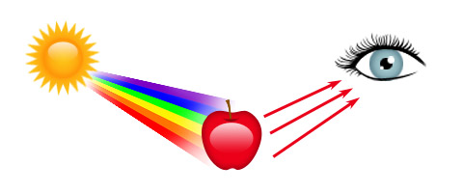
Landanano.com

Slide 11
Color Mixing

Slide 12
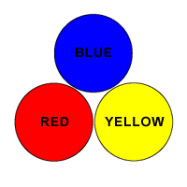
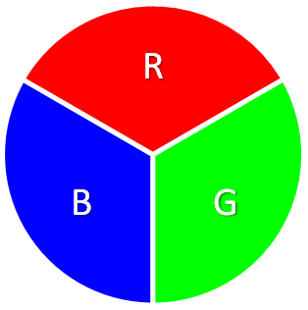
Primary Colors
Hues that cannot be derived or blended from any other hue
Colorhealingtherapy.com
Indezine.com

Slide 13
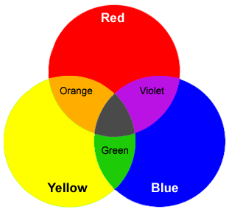
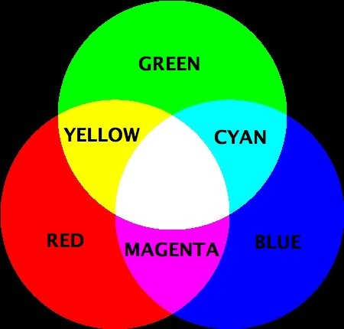
Secondary Colors
Hues are the result of mixing 2 primary colors
Carlton.edu
Designcolors.blogspot.com

Slide 14
Tertiary Colors
Hues are the result of mixing a primary and a secondary

Slide 15
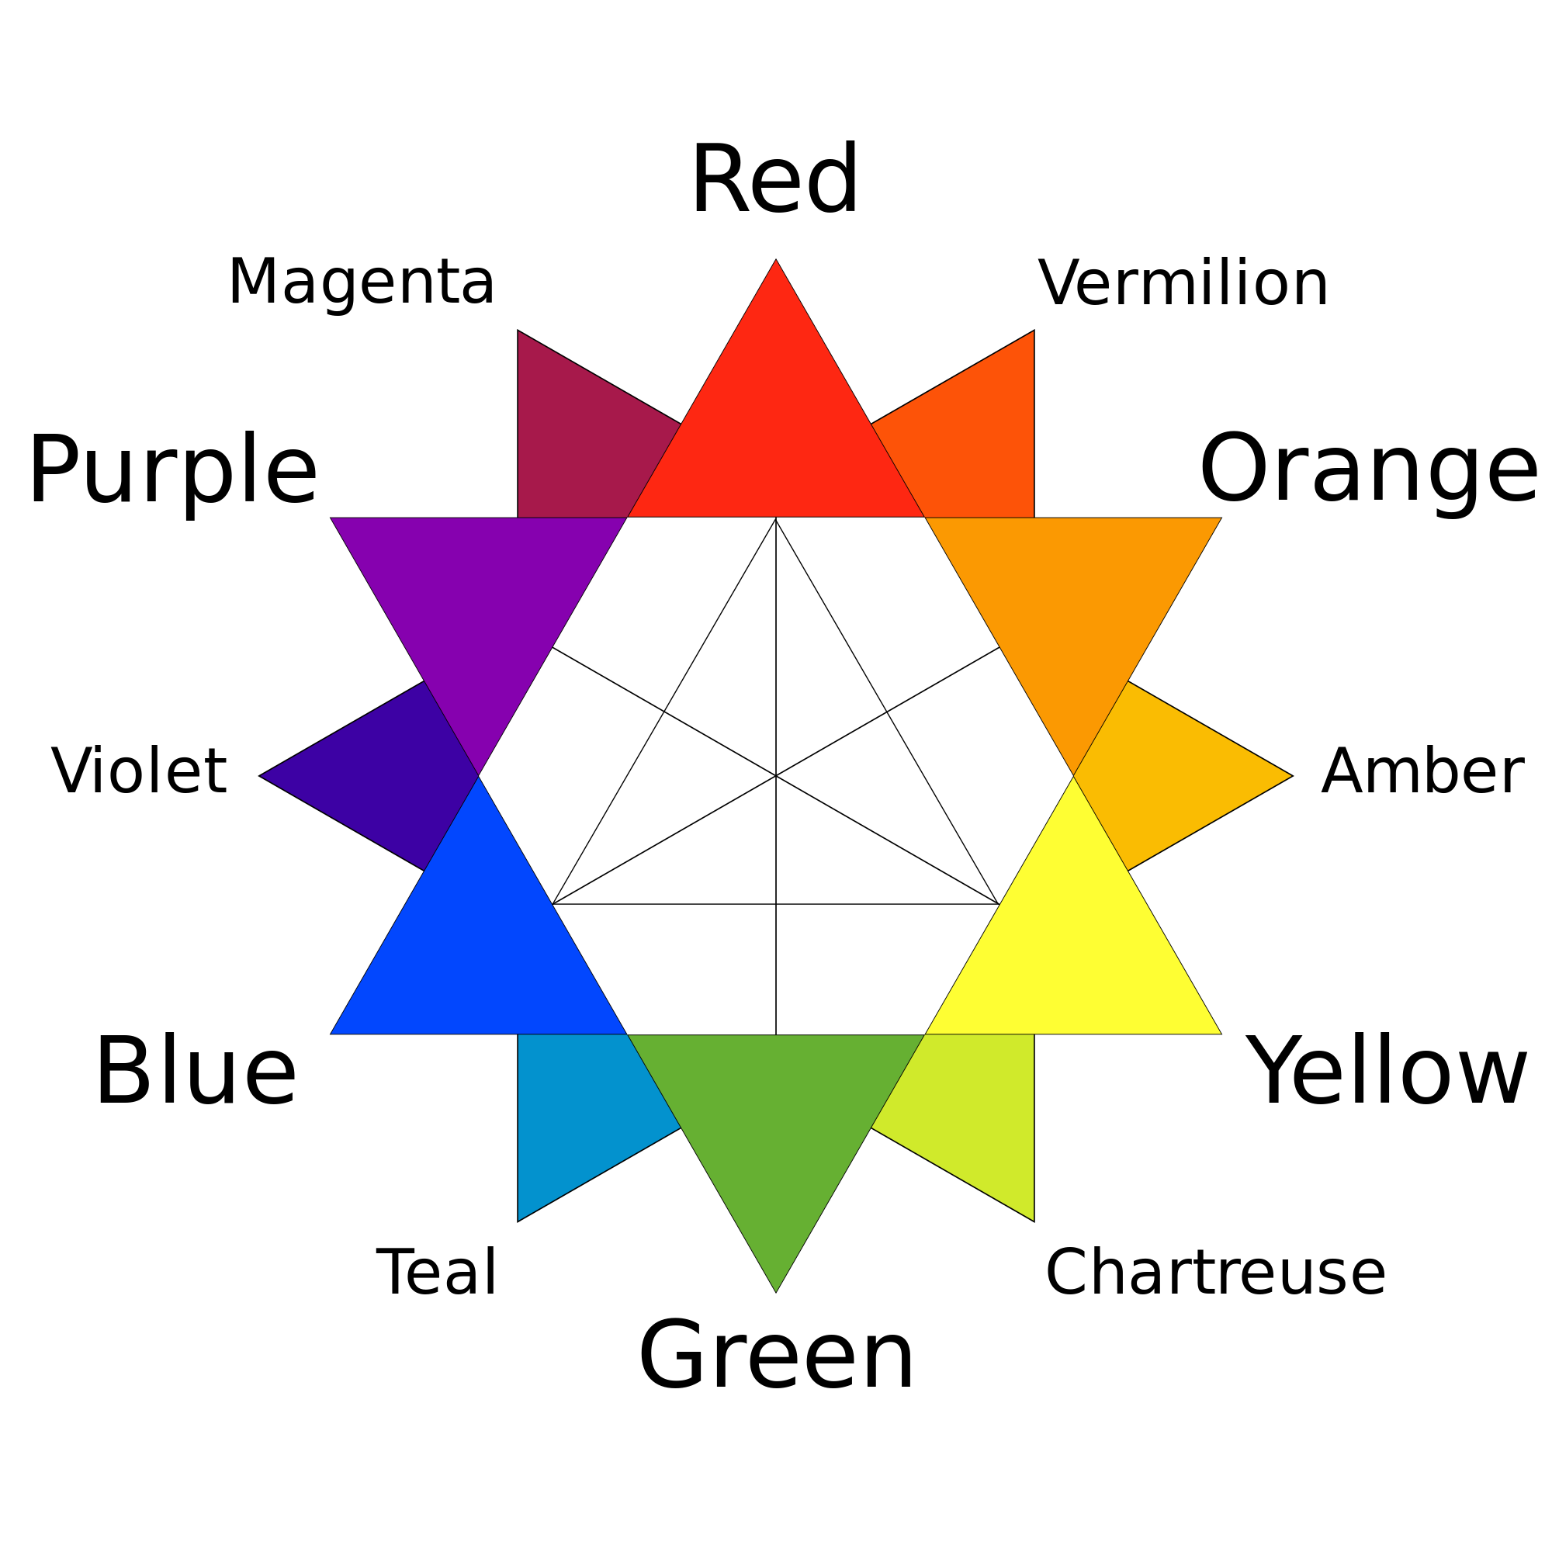
Pigment
Wikipedia.org

Slide 16
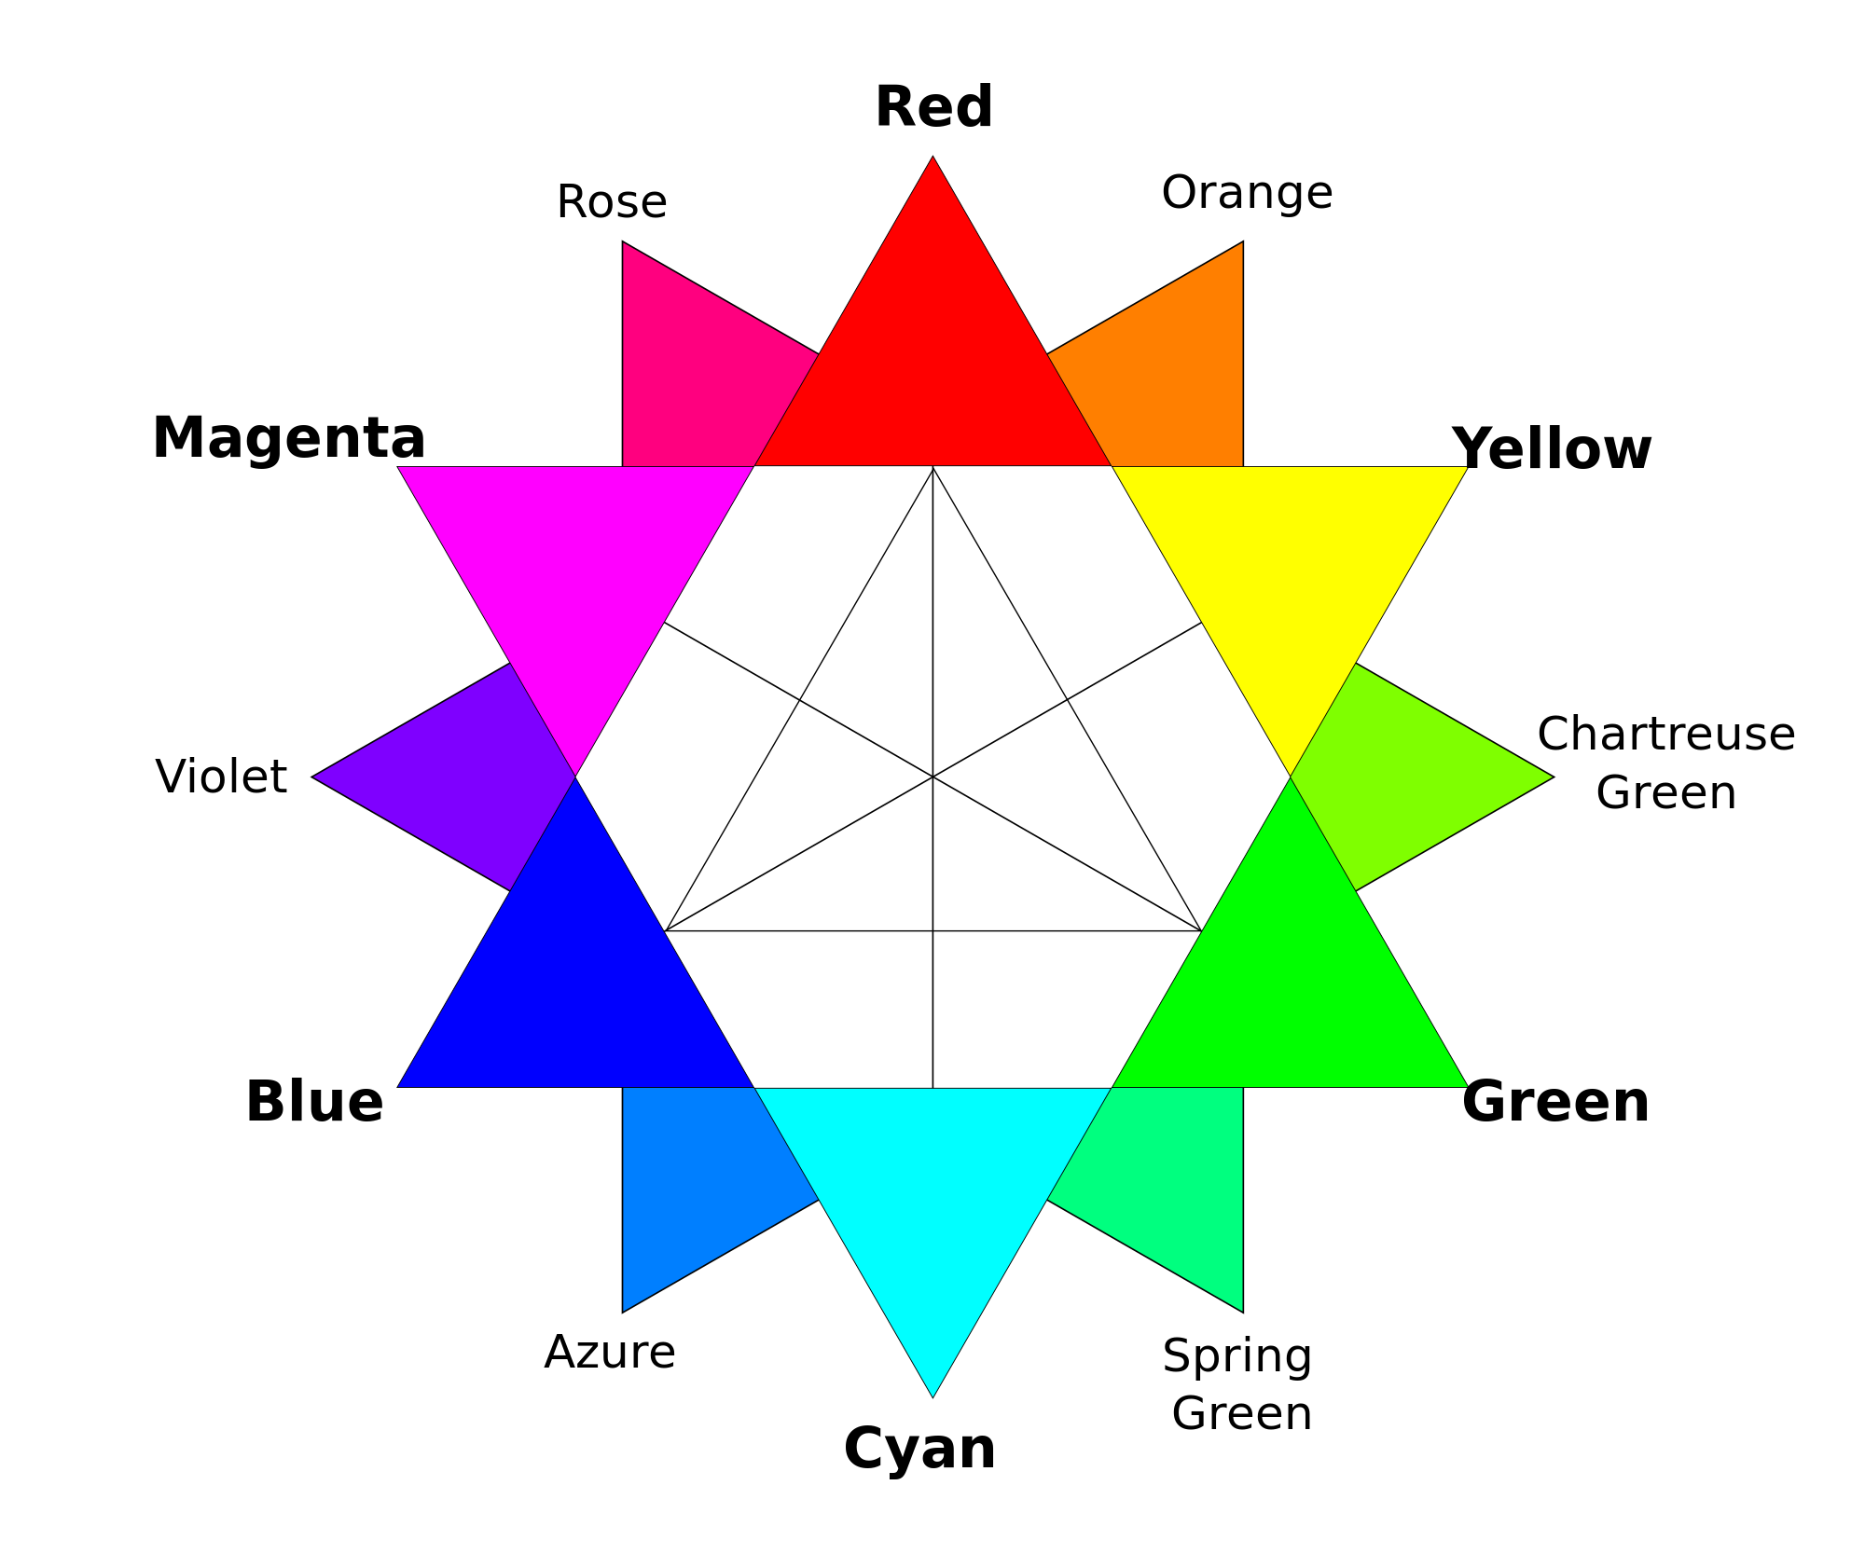
Light
Wikipedia.org

Slide 17
Color Mixing in Light

Slide 18
Filtered Light
When light passes through any material (including air) a portion of the spectrum is absorbed
2 kinds of color mixing in light:
  Subtractive Color Mixing
  Additive Color Mixing

Slide 19
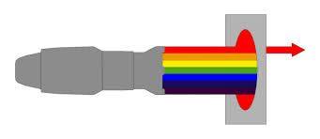
Subtractive Color Mixing in Light
Colored filters allow only their own hue to pass through the filtering medium
They absorb all other wavelengths and convert them to heat
Picture from: specialeventguru.blogspot.com

Slide 20
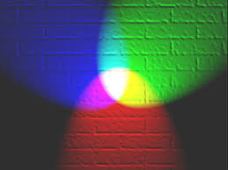
Additive Color Mixing in Light
When several individual hues are transmitted to the eye, added together, and interpreted by the brain
Picture from: Wikipedia.com

Slide 21
Color Mixing in Paint

Slide 22
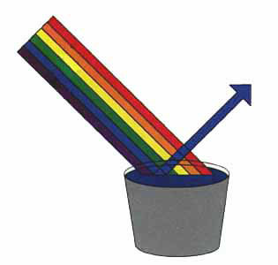
Color Mixing in Paint
Primarily a subtractive process
Mix colors and hues to reflect the color we choose

Slide 23
Integrated Color Wheel

Slide 24
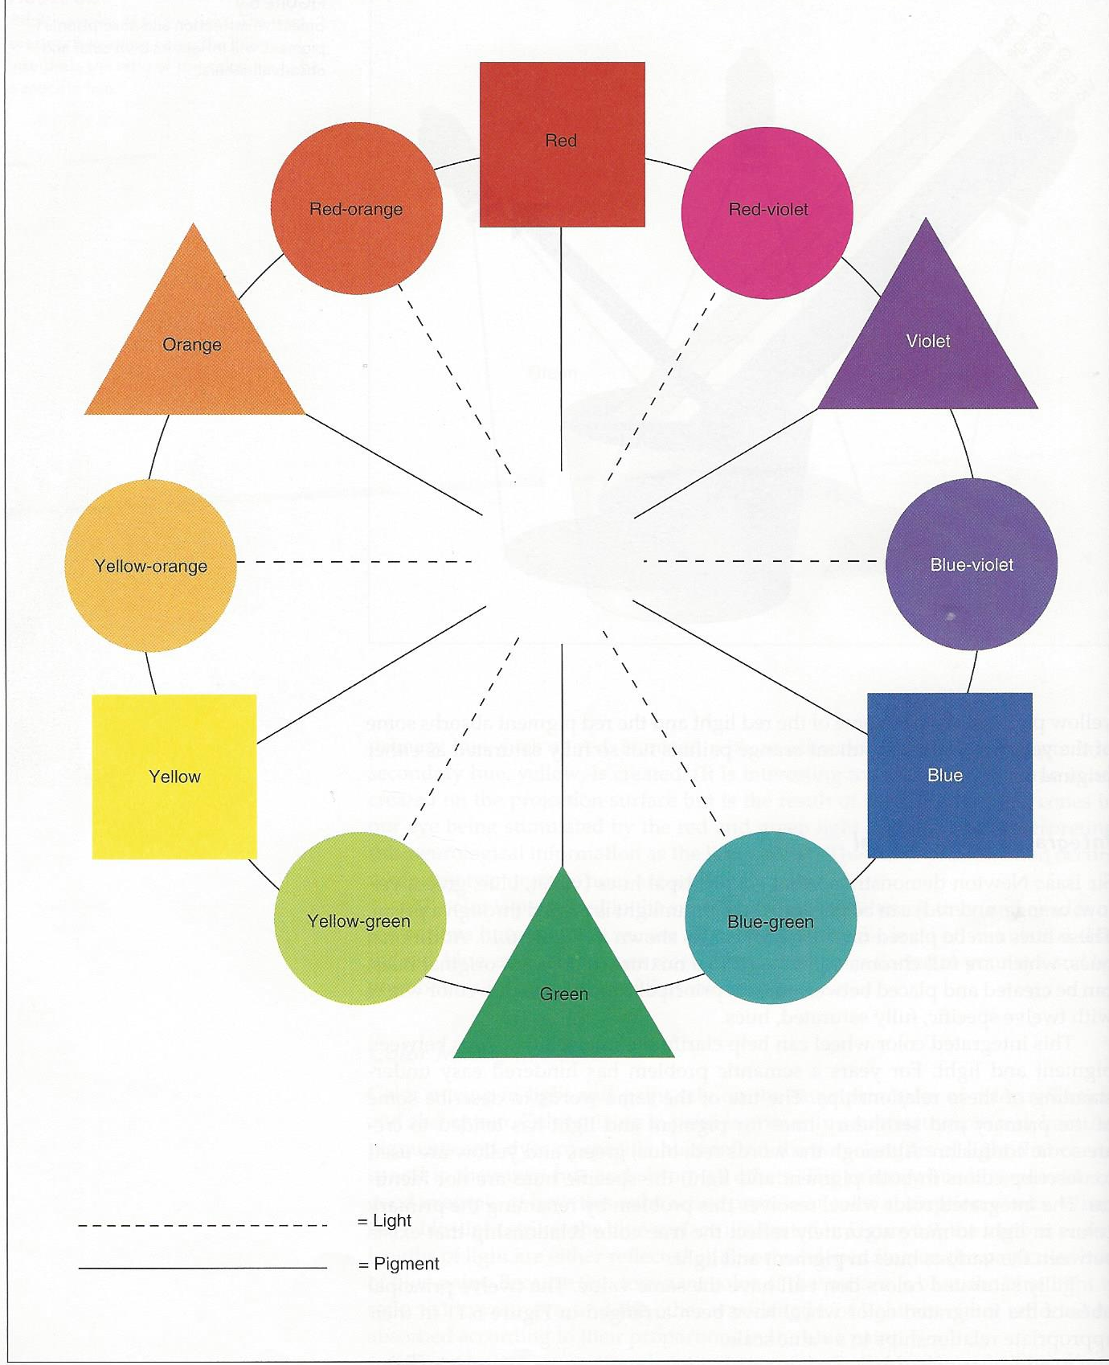

Slide 25
P.S. about Color Theory
Colors of this strength and value are never used in theatre for two main reasons:
  Incredibly expensive
  Fully saturated color isn't particularly appropriate in theatre, the colors would visually dominate everything onstage

Slide 26
Application of Color in Theatre

Slide 27
Application of Color in Theatre
Due to impurities and contaminants found in all stage paints, dyes, lamps and color media color theory is just a theory

Slide 28
Meaning of Color
People react to color.
Constantly changing
Influenced by many factors
  What could factor into people’s reactions of color?

Slide 29
Meaning of Color
Yellow: stimulating, cheerful, exciting, joyful, serene, unpleasant, aggressive, hostile
Orange: warm, happy, merry, exciting, stimulating, hot, disturbed, distressed, unpleasant
Red: happy, affectionate, loving, exciting, striking, active, intense, defiant, powerful, masterful, strong, aggressive, hostile

Slide 30
Meaning of Color
Green: youthful, fresh, leisurely, secure, calm, peaceful, emotionally controlled, ill
Blue: pleasant, cool, secure, comfortable, tender, soothing, social, dignified, sad, strong, full, great
Violet: dignified, stately, vigorous, disagreeable, sad, despondent, melancholy, unhappy, depressing

Slide 31
Meaning of Color
Black: sad, melancholy, vague, unhappy, dignified, stately, strong, powerful, hostile, distressed, fearful, old
White: pure, tender, soothing, solemn, empty
Brown: secure, comfortable, full, sad, disagreeable

Slide 32
Practical Color Use
2 sides of the coin:
  Designers in theatre follow some color guidelines
  Many designers will tell you to blow off convention if it fits the production

Slide 33
Pigment
Scenic designers will generally use hues of medium saturation and value
Costume designers work in a less constricted palette than scene designers
Color proximity: placement and relationship of specific hues
Accent colors: small touches of contrasting colors

Slide 34
Light
White light at full intensity tends to bleach out color on actors faces, costumes, and set
  Primary reason for using colored lights in the theatre
If colors are complimentary the color pallet of other designers is maintained
Colors chosen by other designers help the lighting designer choose the colors they will work with

